Slide 1

Munich Housing Price Analysis
Data Analytics Final Project
Alya Al Anesi

Slide 2

Are you moving to Munich and looking for a home? Do you want to know what you can afford and where?

Slide 3
Stick around while we analyze a dataset to find out the prices of apartments in all parts of Munich.

Slide 4
Tools
The project was created using Python along with the following libraries:
Pandas: For data manipulation and analysis
NumPy: For numerical operations
Matplotlib: For creating plots and visualizations
Seaborn: For enhancing visual aesthetics and creating color palettes
Scikit-learn (sklearn)
Scipy.stats: For statistical computations, particularly for calculating Pearson correlation coefficient
Warnings: For suppressing warnings

Slide 5
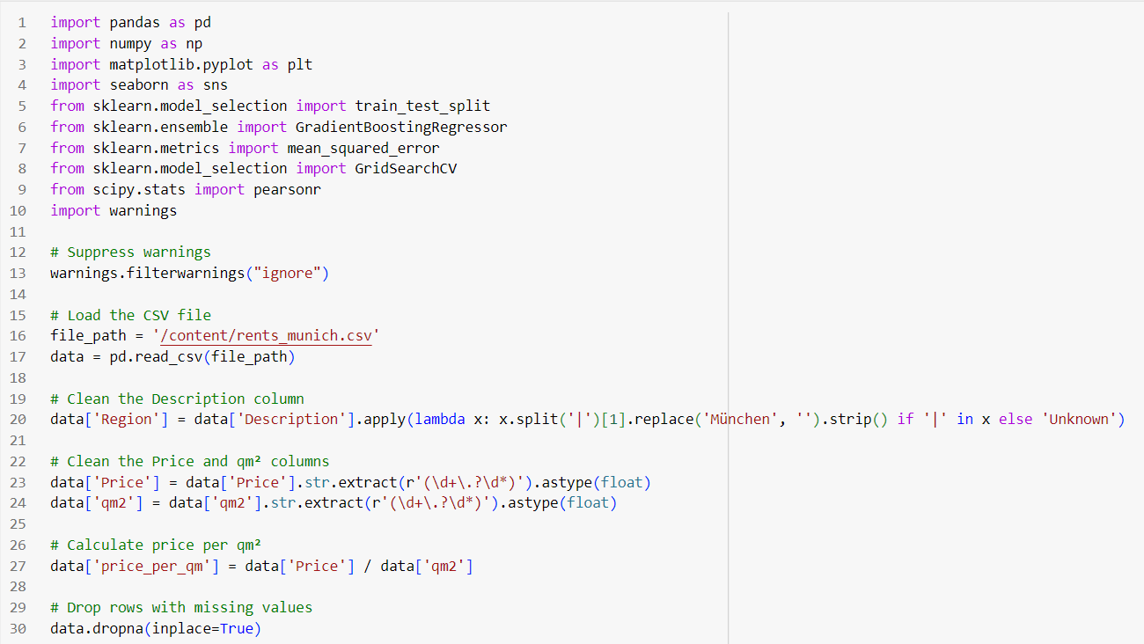
The Code 1/6

Slide 6
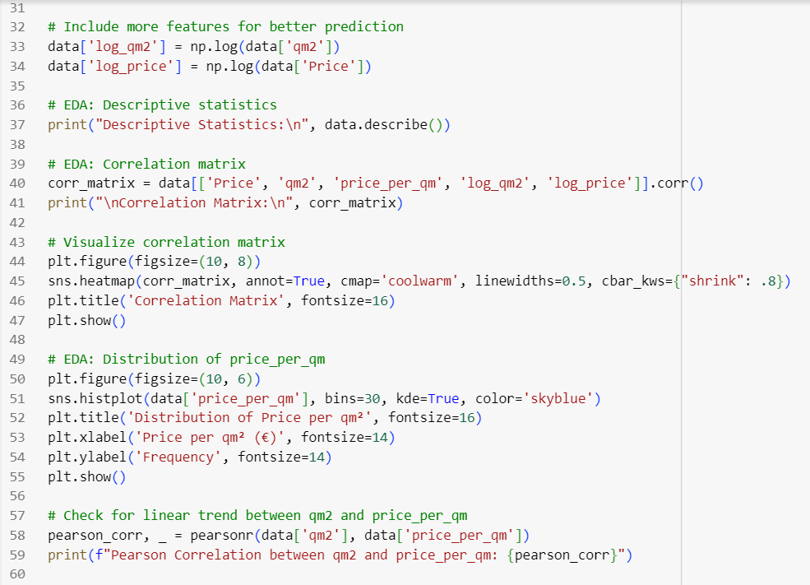
The Code 2/6

Slide 7
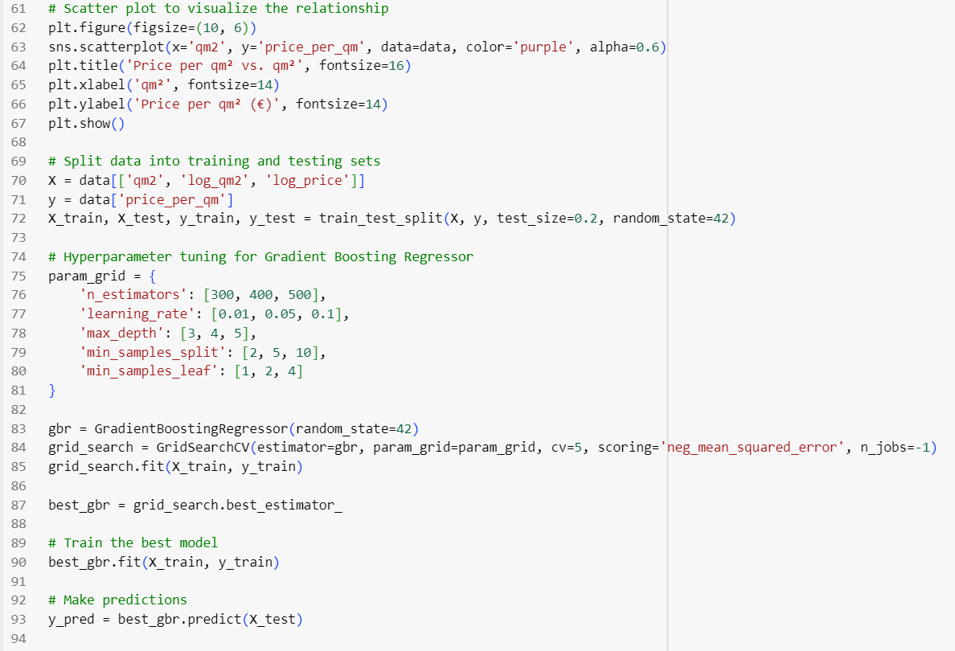
The Code 3/6

Slide 8
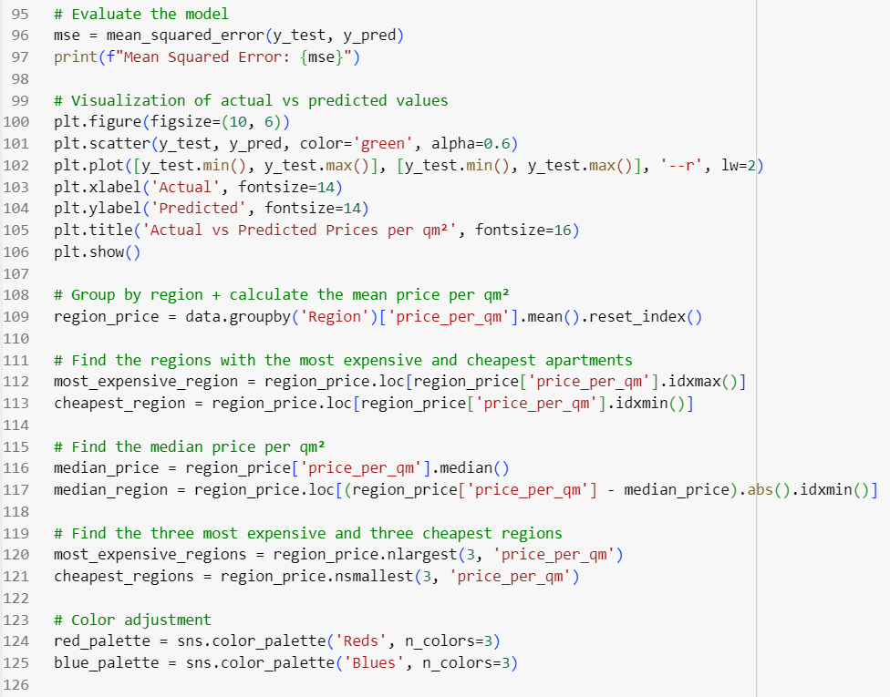
The Code 4/6

Slide 9
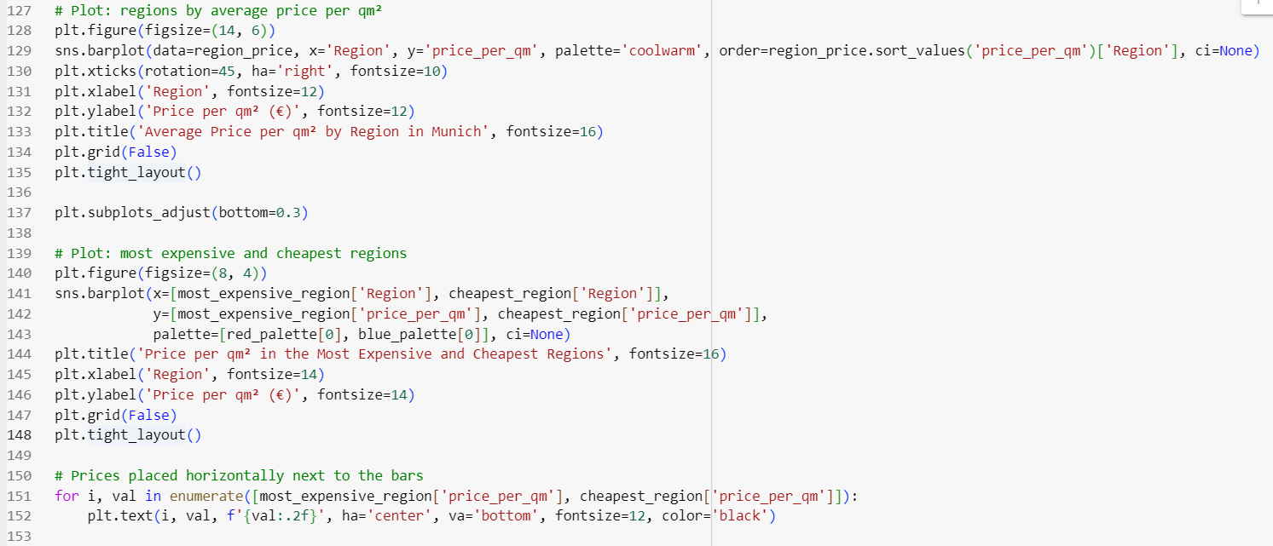
The Code 5/6

Slide 10
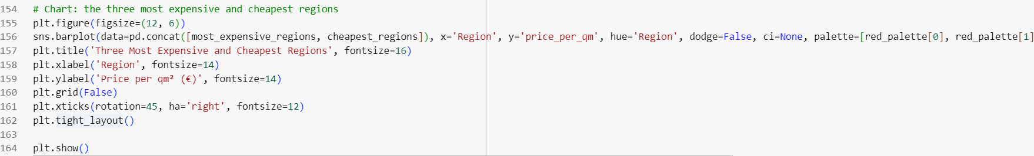
The Code 6/6

Slide 11
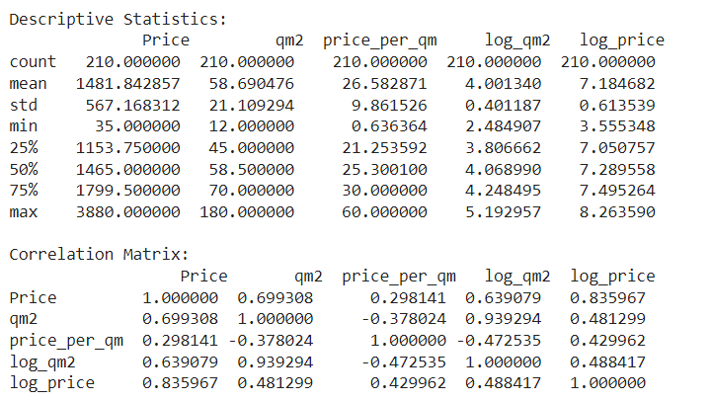
Descriptive Statistics

Slide 12
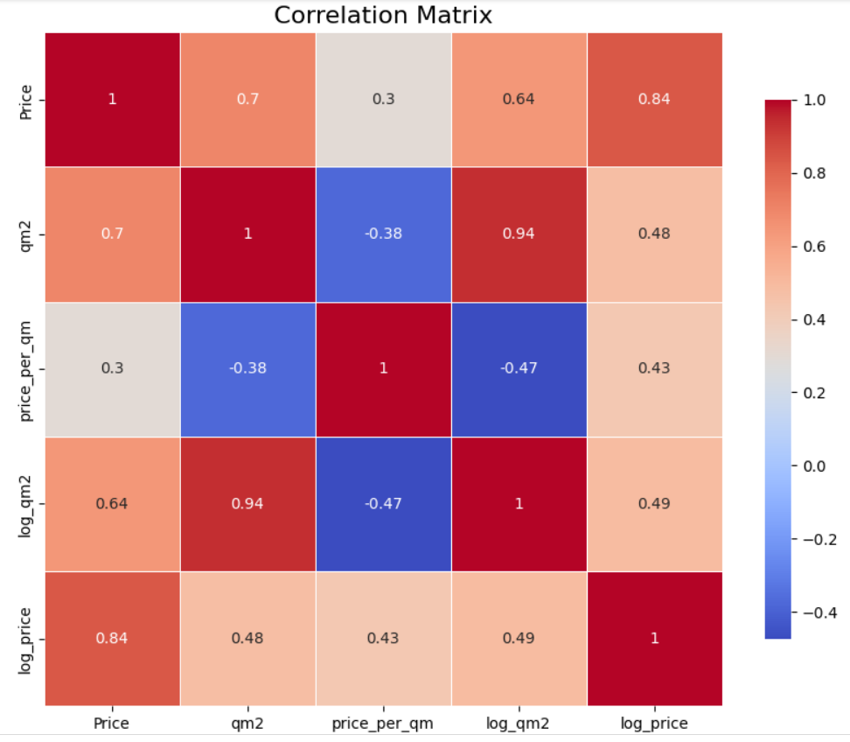
Correlation Matrix

Slide 13
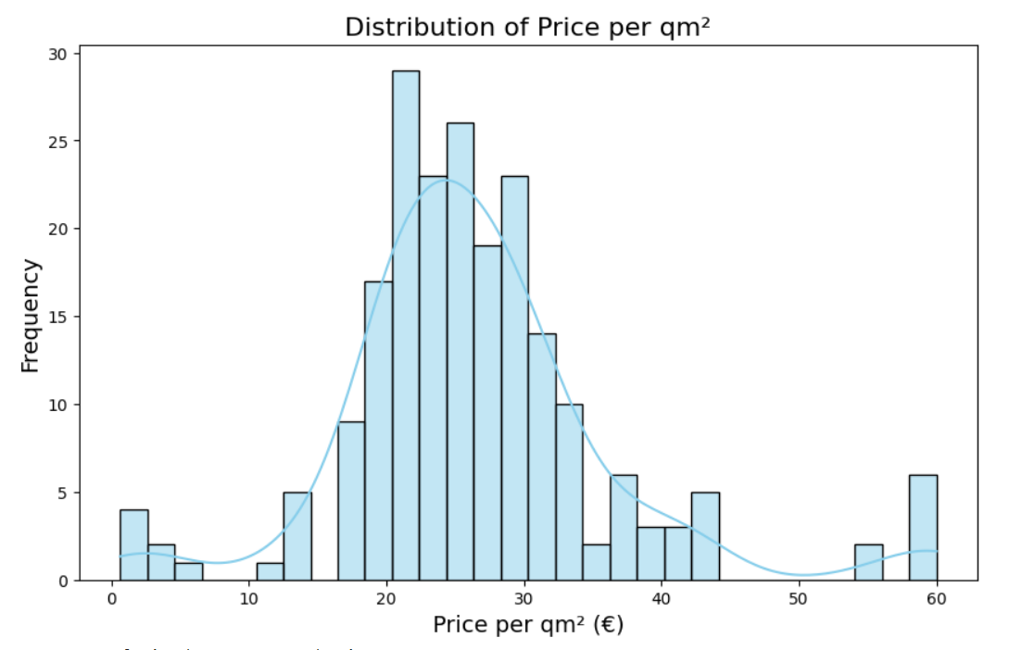
Distribution of Price per qm²

Slide 14
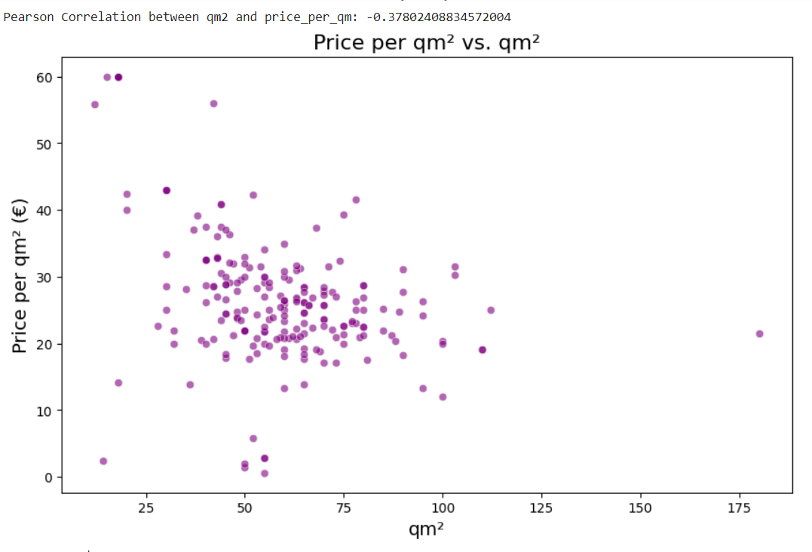
Price per qm² vs. qm²

Slide 15
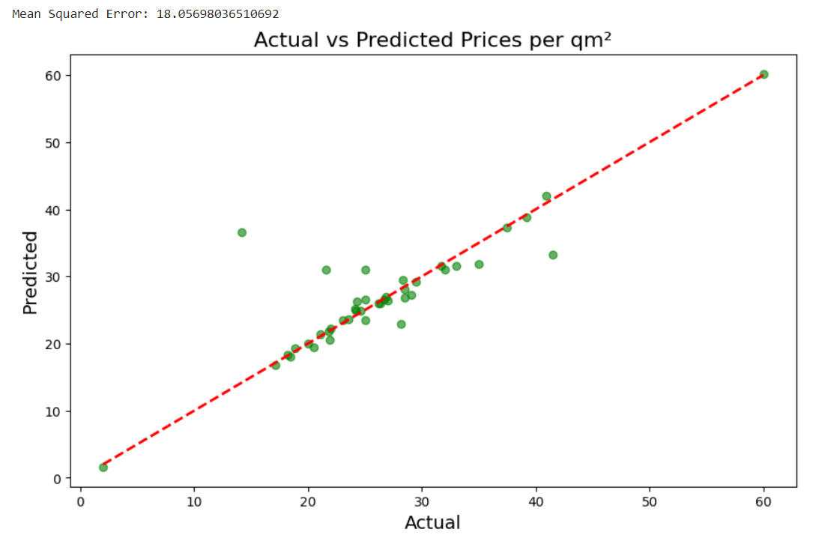
Actual vs. Predicted Prices per qm²

Slide 16
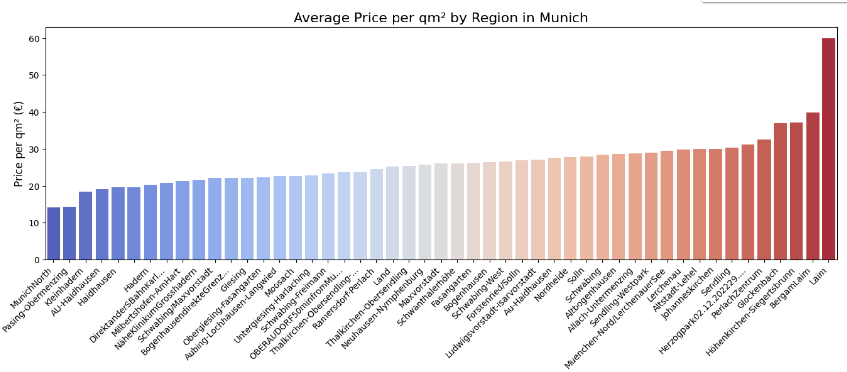
Average Price per qm² by Region in Munich

Slide 17
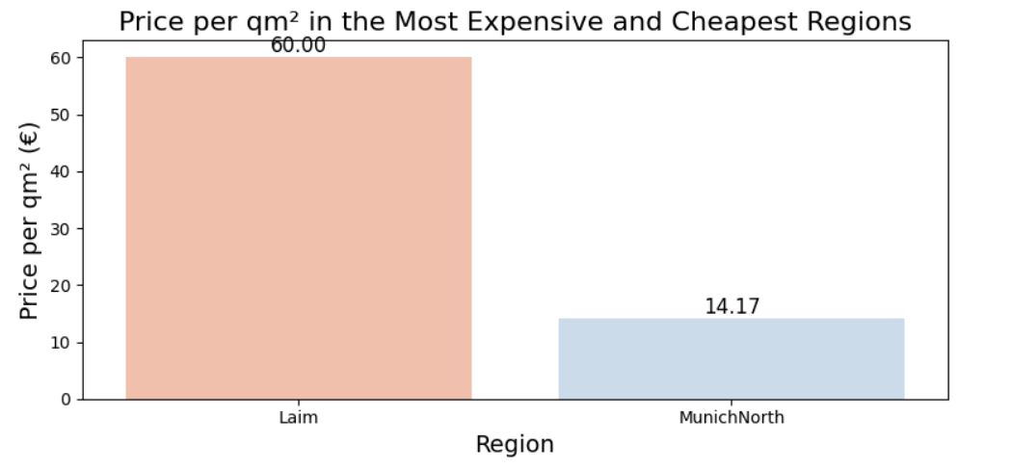
Price per qm² in the Most Expensive and Cheapest Regions

Slide 18
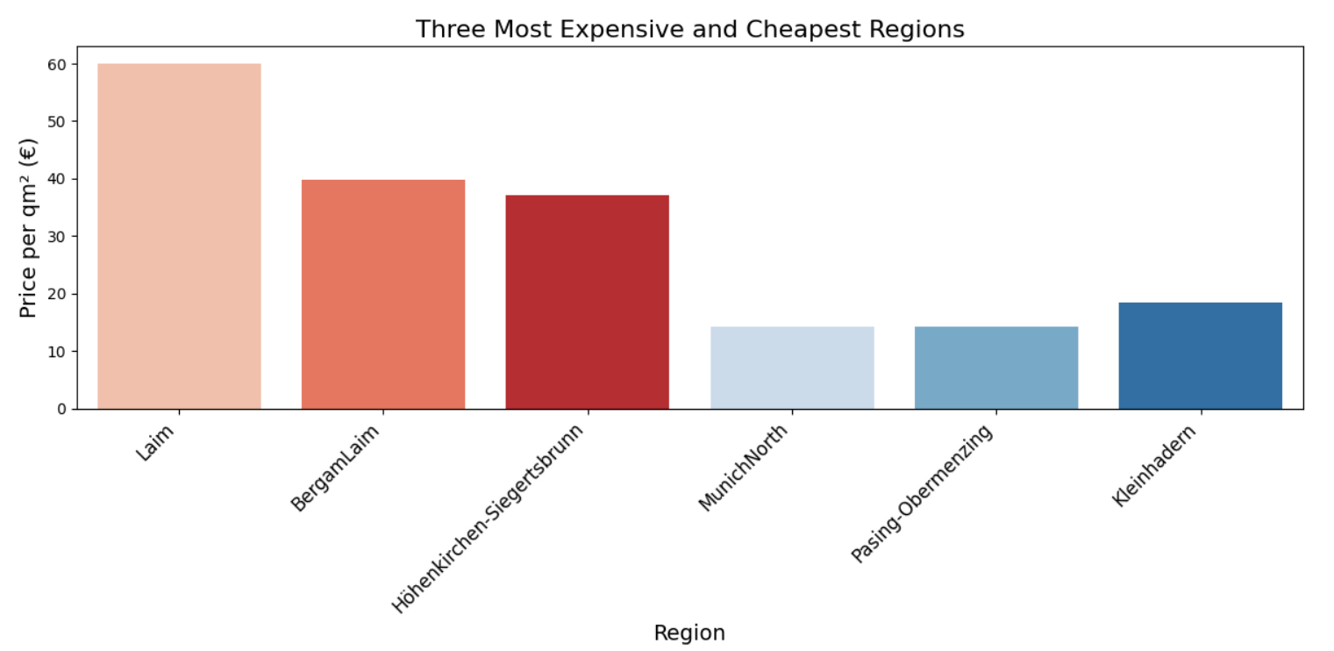
Three Most Expensive and Cheapest Regions

Slide 19
Incorporate more data sources and features
Fine-tune the model
Enhance the model explanations
Future Improvements

Slide 20
Thank you!

